Slide 1
BITCOIN MODELING
Okba Nairi
Mohamed Abdellaoui

Slide 2
LITERATURE REVIEW
Bitcoin is the most accepted cryptocurrency in the world, which makes it attractive for investors and traders. However, the great challenge in predicting the Bitcoin price is its high volatility. Therefore, the prediction of its behavior and its dynamics is highly significant for financial markets. One popular approach for modeling Bitcoin prices is the Autoregressive Integrated Moving Average (ARIMA) model. Ghiassi et al. (2018) used an ARIMA model to forecast the price of Bitcoin and found that the model performed very well in predicting future prices. Similarly, Zhang and Wei (2020) also used an ARIMA model to forecast Bitcoin prices and found that it outperformed other commonly used models such as VAR (Vector Autoregessive Model).
Another important aspect of Bitcoin modeling is volatility. Since Bitcoin prices are relatively new and exhibit high variance, it is important to develop models that can accurately capture its volatility. The Generalized Autoregressive Conditional Heteroskedasticity (GARCH) model is commonly used for this purpose. Katsiampa (2017) used different variations of GARCH models to analyze the volatility of Bitcoin prices. She found that it exhibited significant asymmetry, with negative shocks having a stronger impact on volatility than positive shocks.

Slide 3
We are using an ARIMA (Autoregressive Integrated Moving Average) model for time series forecasting because it can capture the patterns of past data to make predictions about future trends. ARIMA models are often used in financial analysis, economics, and engineering to forecast future values of a variable based on historical data. Additionally, we have decided to incorporate external regressors into our ARIMA model to improve its accuracy. External regressors are additional variables that can influence the target variable we are trying to forecast. By including these variables in the model, we can account for their impact on the target variable and produce more accurate forecasts. In our case we found two variables that has significant impact on the bitcoin prices (days destroyed, cost per transaction) :: The file containing the external regressors will be provided the project file. ::
BITCOIN PRICE MODEL

Slide 4
library(readxl)
project_dyn <- read_excel("C:/Users/moahm/OneDrive/Desktop/project_dyn/project_dyn.xlsx", col_types = c("date", "numeric", "numeric", "numeric")) library(forecast)
library(tseries) #transform data to tseries project_dy<- ts(project_dyn) #test if data is stationary adf.test(project_dy[,2])
## ## Augmented Dickey-Fuller Test ## ## data: project_dy[, 2] ## Dickey-Fuller = -3.5912, Lag order = 4, p-value = 0.03712 ## alternative hypothesis: stationary
model_price2<- arima(project_dy[,2],order = c(3,1,3)) model_price2
As we can see the ADF test gives a p-value lower than 0,05 meaning the data we are using is stationary.
We used a loop function to choose the best ARIMA order for our time series data. The loop function went through different combinations of p, d, and q values and calculated the AIC (Akaike Information Criterion) for each model. The model with the lowest AIC value was chosen as the best model. Finally, we fit the chosen model to the data and used it to make forecasts.

Slide 5
p_values <- 0:3 d_values <- 0:1 q_values <- 0:3 # Initialize variables to store the best model and its AIC best_model <- NULL best_aic <- Inf # Loop through all possible combinations of p, d, and q values for (p in p_values) { for (d in d_values) { for (q in q_values) { # Fit an ARIMA model with the current p, d, and q values model <- arima(project_dy[,2], order = c(p, d, q)) if (!any(is.na(diag(model$var.coef)))) { # Calculate the AIC aic <- AIC(model) # Check if the current model has a lower AIC than the best model so far if (aic < best_aic) { best_aic <- aic best_model <- model } } } } }
This code uses a loop to iterate through all possible combinations of ARIMA orders (p, d, q) and fits an ARIMA model for each combination. It then calculates the AIC (Akaike Information Criterion) for each model and selects the model with the lowest AIC as the best model. The final output is the ARIMA order for the best model.

Slide 6
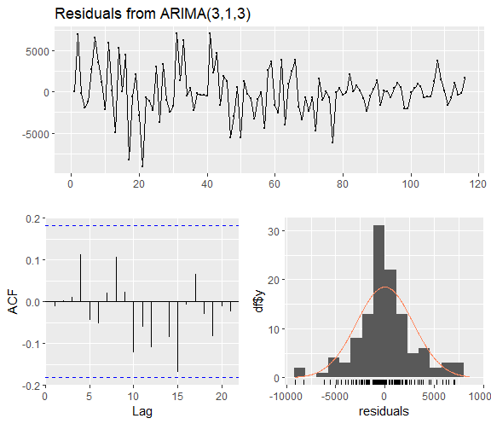
## Call: ## arima(x = project_dy[, 2], order = c(3, 1, 3)) ## ## Coefficients: ## ar1 ar2 ar3 ma1 ma2 ma3 ## 1.1488 -1.1746 0.2447 -0.9006 0.8851 0.1133 ## s.e. 0.2704 0.2567 0.2632 0.2788 0.2888 0.2801 ## ## sigma^2 estimated as 8273420: log likelihood = -1081.29, aic = 2176.57
risiduals<-checkresiduals(model_price2)
Box.test(model_price2$residuals,type = "Ljung-Box", lag= 10 )
## ## Box-Ljung test ## ## data: model_price2$residuals ## X-squared = 5.6762, df = 10, p-value = 0.8417
As shown in box test, we can see that the p-value is superior to 0,05 meaning the residuals are not correlated.
Residuals are not dependant as shown in the ACF(no noise) and they are normally distribution.

Slide 7
fit3<-forecast(model_price2, h=6)
#make arima model with auto generated order (1,0,1) which serves as a short-term process , with external regressors for more accuracy model_price<- auto.arima(project_dy[,2],seasonal = TRUE, xreg= as.matrix(project_dy[,3:4])) model_price
## Series: project_dy[, 2] ## Regression with ARIMA(1,0,1) errors ## ## Coefficients: ## ar1 ma1 intercept daysdestroyed costpertransaction ## 0.9510 0.3368 30332.500 -1e-04 30.6755 ## s.e. 0.0262 0.1005 1500.477 0e+00 9.3769 ## ## sigma^2 = 7826508: log likelihood = -1084.19 ## AIC=2180.38 AICc=2181.15 BIC=2196.9
#forecast the future values of the external regressors that will be used to forecast the price daysdestroyed_<- forecast(project_dy[,3], h = 6) costpertransaction_<-forecast(project_dy[,4], h=6) #combine the forecast of the external regressors to 1 matrix newxreg= as.matrix(cbind(daysdestroyed_$mean,costpertransaction_$mean)) #forecast the data fit2<-forecast(model_price, xreg=newxreg, h=6)
The xreg argument is the a matrix that contains the external regressors that will be used to help forecast the prices.
the newxreg is the matrix used later for the forecast that contains the future values of the external regressors.

Slide 8
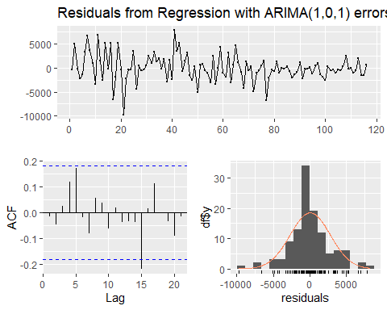
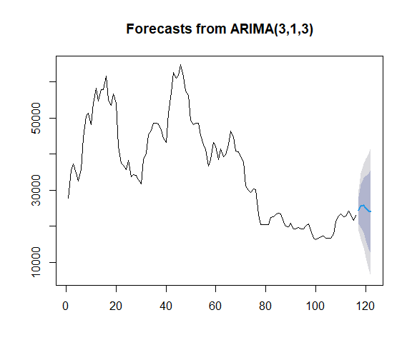
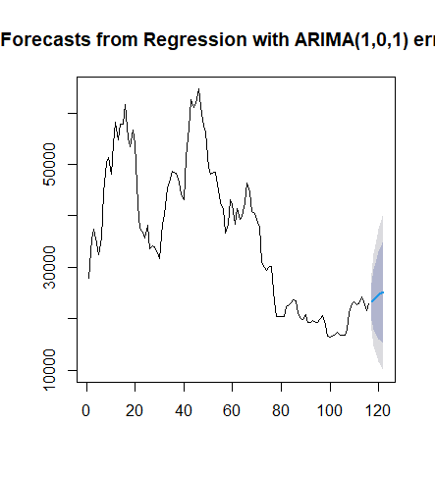
#check for lag and distribution residual<-checkresiduals(model_price)
#test for the auto-correlation of the residuals Box.test(model_price$residuals,type = "Ljung-Box", lag= 20 )
## ## Box-Ljung test ## ## data: model_price$residuals ## X-squared = 18.129, df = 20, p-value = 0.5789
Although the residuals are not normally distributed as much as the first model, this auto generated model lowers AIC.
The ACF graph indicates white noise.
fit3<-forecast(model_price2,h=6) fit2<-forecast(model_price,xreg=newxreg, h=6)

Slide 9
fit3
## Point Forecast Lo 80 Hi 80 Lo 95 Hi 95 ## 117 24371.69 20656.98 28086.39 18690.533 30052.84 ## 118 25541.84 19578.18 31505.51 16421.204 34662.48 ## 119 25765.41 18216.67 33314.14 14220.616 37310.20 ## 120 24988.40 16046.79 33930.01 11313.390 38663.41 ## 121 24119.51 13746.40 34492.61 8255.216 39983.79 ## 122 24088.68 12305.22 35872.13 6067.441 42109.92
fit2
## Point Forecast Lo 80 Hi 80 Lo 95 Hi 95 ## 117 23298.48 19713.23 26883.74 17815.308 28781.66 ## 118 23735.97 17890.33 29581.61 14795.833 32676.10 ## 119 24152.00 16841.08 31462.91 12970.922 35333.07 ## 120 24547.62 16128.42 32966.82 11671.562 37423.67 ## 121 24923.83 15615.32 34232.35 10687.686 39159.98 ## 122 25281.60 15236.42 35326.78 9918.818 40644.38
After conducting diagnostic tests on both models and finding that they both meet the necessary criteria, the model with the lowest AIC can be considered the better model. In this case , the "model_price2“ has the lower AIC, indicating that it is a better fit for the data. Though the inclusion of external regressors in this model improves its accuracy, as they provide additional information to the model, the model_price2 has better aic(lower) and better statistical results.
Which model to choose?

Slide 10
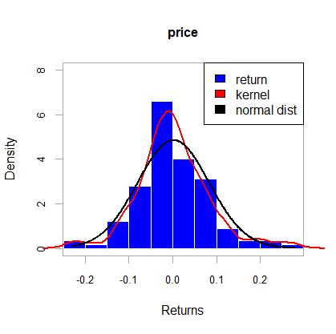
BITCOIN VOLATILITY
It is common practice to use a GARCH model for financial time series because financial data is often characterized by volatility clustering, which means that periods of high volatility tend to be followed by periods of high volatility, and periods of low volatility tend to be followed by periods of low volatility.
To choose the optimal model, including the number of lagged terms for both the GARCH and ARMA models, we ran different settings and made the decision based on AIC value and empirical analysis of the data.
Finally, we chose EGARCH(4,4), which includes four lagged terms of the conditional variance and four lagged terms of the absolute value of the standardized residual. This means that the model is capturing both short- and long-term volatility patterns in the data, as well as the asymmetric responses to positive and negative shocks. This allows for the model to capture the phenomenon of volatility clustering, where periods of high volatility tend to follow periods of high volatility and vice versa.
For the ARMA order, we opted for armaOrder(5,0) to capture to time-dependent patterns in the mean of the data.
As for the distribution of the mean errors, we noted that the returns do not follow a normal distribution, but rather a skewed t-distribution as indicated by the graph below.

Slide 11
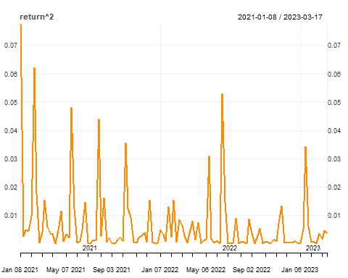
BITCOIN VOLATILITY
library(rugarch)
library(xts)
library(PerformanceAnalytics)
library(quantmod)
library(readxl)
library(tseries)
BTC_data <- read_excel("C:/Users/okban/OneDrive/Documents/project/bitcoin_price.xlsx") BTC_ts <- subset(BTC_data, select= -c(date)) BTC_ts <- xts(BTC_ts, order.by = as.Date(BTC_data$date)) return <- CalculateReturns(BTC_ts$price) return <- tail(return, -1) chart_Series(return^2)
The returns exhibit volatility clustering, which makes the GARCH model effective for forecasting future volatility.
## KPSS Test for Level Stationarity ## ## data: return ## KPSS Level = 0.23318, Truncation lag parameter = 4, p-value = 0.1
P-value>0.05, the data is stationary and there is no need to calculate the Log-returns.

Slide 12
BITCOIN VOLATILITY
## Estimate Std. Error t value Pr(>|t|) ## mu 0.005425 0.000001 3633.73 0 ## ar1 0.381119 0.000112 3395.12 0 ## ar2 -0.180520 0.000029 -6287.65 0 ## ar3 0.063254 0.000033 1934.12 0 ## ar4 0.062768 0.000066 954.38 0 ## ar5 -0.098478 0.000035 -2796.43 0 ## omega -0.587661 0.000181 -3247.44 0 ## alpha1 0.399307 0.000158 2521.78 0 ## alpha2 0.585892 0.000153 3820.31 0 ## alpha3 -0.455996 0.000126 -3628.85 0 ## alpha4 0.138892 0.000042 3270.03 0 ## beta1 0.351534 0.000077 4573.87 0 ## beta2 0.212200 0.000082 2590.17 0 ## beta3 -0.190369 0.000082 -2309.59 0 ## beta4 0.515170 0.000096 5365.82 0 ## gamma1 -0.486628 0.000204 -2380.17 0 ## gamma2 -0.986634 0.000244 -4050.10 0 ## gamma3 0.293569 0.000099 2980.08 0 ## gamma4 0.451910 0.000131 3461.05 0 ## skew 1.284316 0.000948 1354.31 0 ## shape 4.749223 0.001248 3805.29 0
P-value of coefficients are all zero. They are all significant.
mod_specify <- ugarchspec(variance.model = list(model = "eGARCH", garchOrder = c(4,4)), mean.model = list(armaOrder = c(5,0)), distribution.model = "sstd") mod_fitting <- ugarchfit(mod_specify, data = return, solver.control = list(trace=0)) mod_fitting
plot(mod_fitting, which="all")
## Weighted Ljung-Box Test on Standardized Residuals ## ------------------------------------ ## statistic p-value ## Lag[1] 0.06536 0.7982 ## Lag[2*(p+q)+(p+q)-1][14] 6.43444 0.9677 ## Lag[4*(p+q)+(p+q)-1][24] 10.32611 0.7888 ## d.o.f=5 ## H0 : No serial correlation
## Adjusted Pearson Goodness-of-Fit Test: ## ------------------------------------ ## group statistic p-value(g-1) ## 1 20 16.30 0.6369 ## 2 30 24.57 0.7006 ## 3 40 28.65 0.8883 ## 4 50 41.09 0.7819
P-values for different lags is higher than 0.05, which indicates that there is no serial correlation between the variables.
P-values for different groups is significantly higher than 0.05. Thus, the distribution fits the data well.

Slide 13
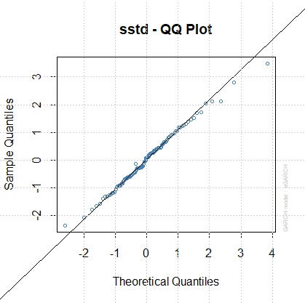
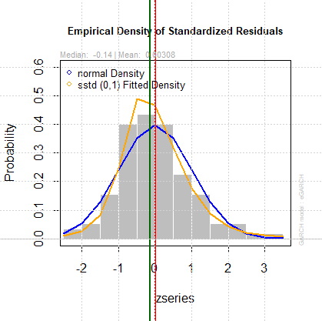
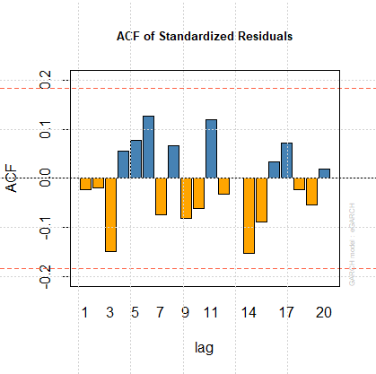
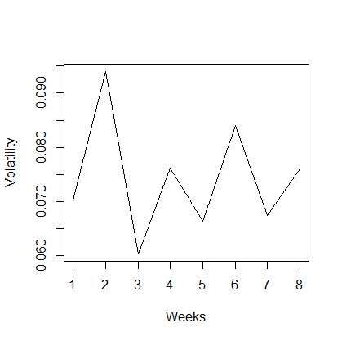
The skewed student t-distribution, as indicated by the tests, is aligned with the data.
The model residuals are white noise. Therefore, it is adequately capturing the correlation structure of the data.
n_periods <- 8 forecast <- ugarchforecast(fitORspec = mod_fitting, n.ahead= n_periods) vol_forecast <- as.numeric(sigma(forecast)) forecast
plot(vol_forecast, type = "l", xlab = "Weeks", ylab = "Volatility")
Series Sigma
## T+1 0.0399035 0.07032 ## T+2 -0.0041866 0.09398 ## T+3 -0.0011446 0.06035 ## T+4 0.0175274 0.07619 ## T+5 0.0073662 0.06640 ## T+6 -0.0004345 0.08397 ## T+7 0.0041407 0.06745 ## T+8 0.0075223 0.07597
Here, we run the forecast for the next 8 weeks (17 March to May 12th).

